Slide 1

Project presentation on :- PFA HOUSING PROJECT
Submitted by :
Pittala, Dheerajkumar

Slide 2
Table Of Contents :-
1. Introduction
1.1 Problem Statement and understanding
2. EDA steps and Visualization
3. Steps and assumptions used to complete the project
3.1 Data Preprocessing Done
3.2 Problem solving approaches
3.3 Set of assumptions related to the problem under consideration
4. Model Dashboard
5. Finalized Model
6. Conclusion
7. Acknowledgement

Slide 3

INTRODUCTION Problem statement and understanding
A US-based housing company named Surprise Housing has decided to enter the Australian market.
The company uses data analytics to purchase houses at a price below their actual values and flip them at a higher price. For the same purpose, the company has collected a data set from the sale of houses in Australia.
We are required to build a model using Machine Learning in order to predict the actual value of the prospective properties and decide whether to invest in them or not.

Slide 4
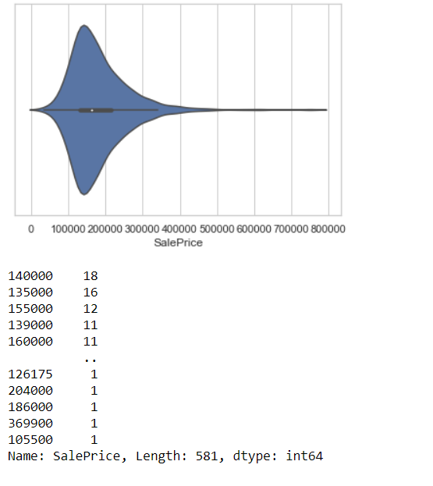

EDA steps and Visualization
Observation:
Maximum number of SalePrice lies between 140000 and 230000

Slide 5
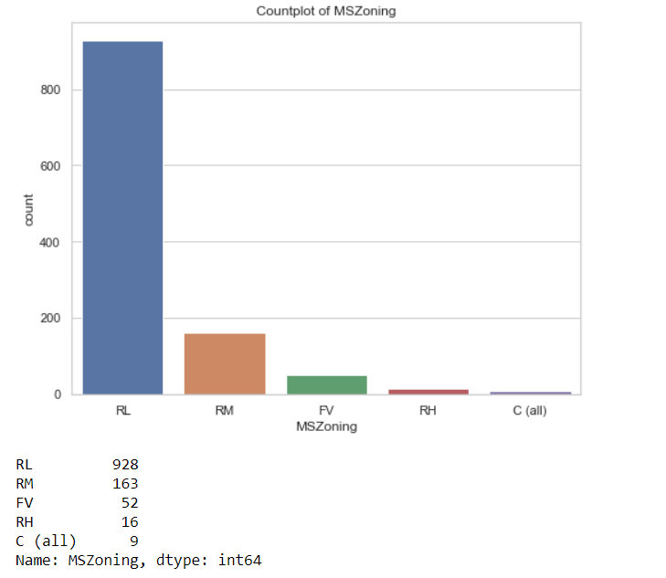
Observation:
Maximum, 928 number of MSZoning are RL.

Slide 6
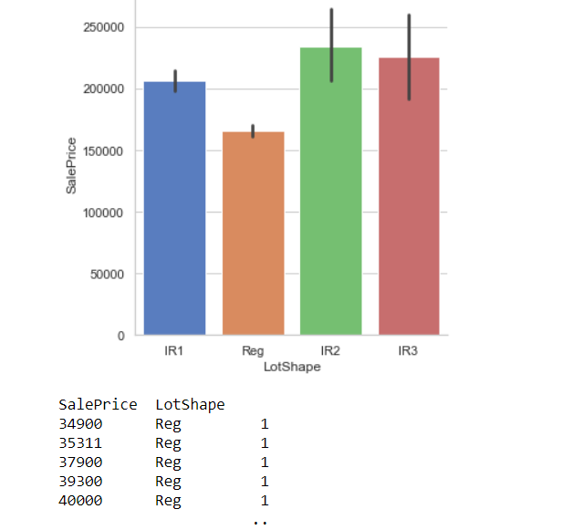
Observation:
SalePrice is maximum with IR2 LotShape.

Slide 7
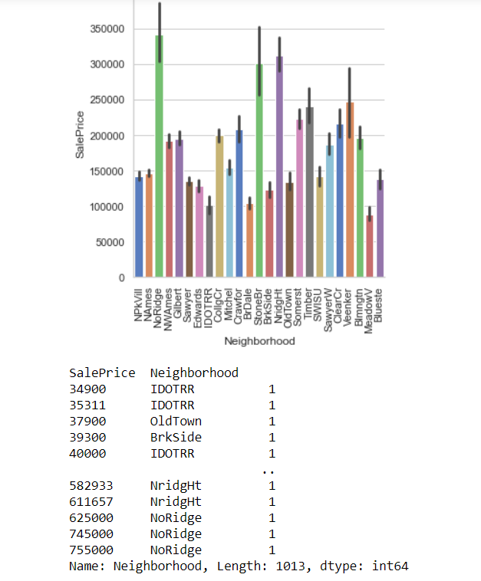
Observation:
SalePrice is maximum with NoRidge Neighborhood.

Slide 8
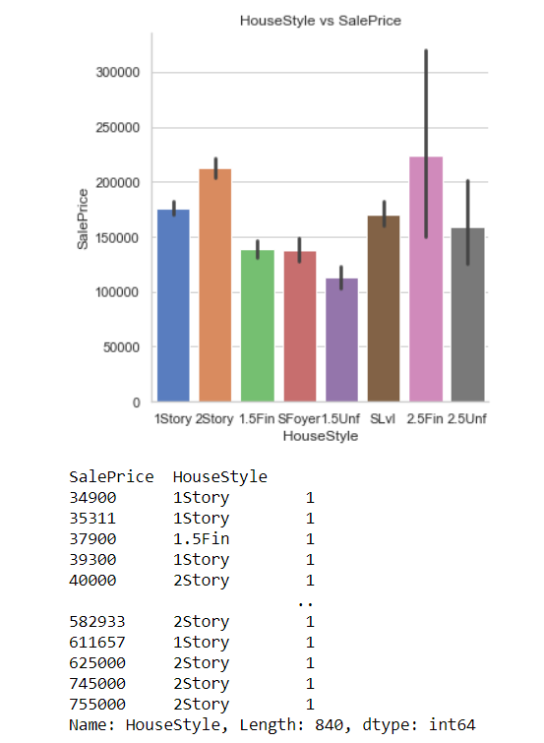
Observation:
SalePrice is maximum with 2.5Fin HouseStyle.

Slide 9
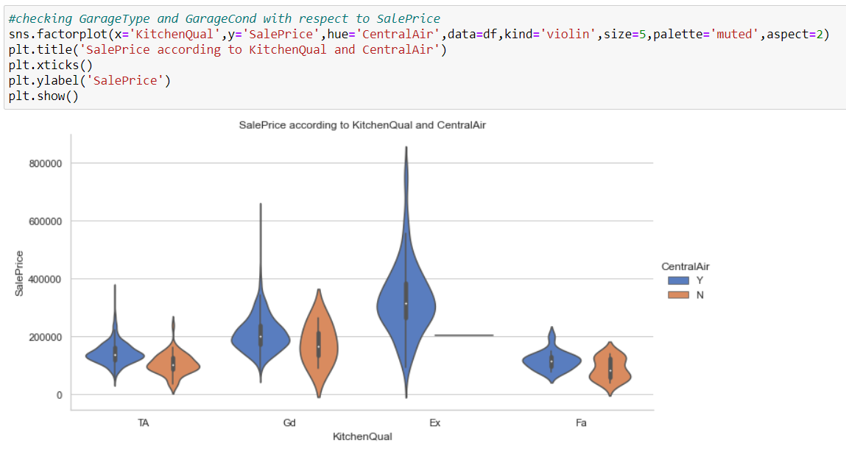
Observation:
SalePrice is maximum with Ex kitchenQual and CentralAir.

Slide 10
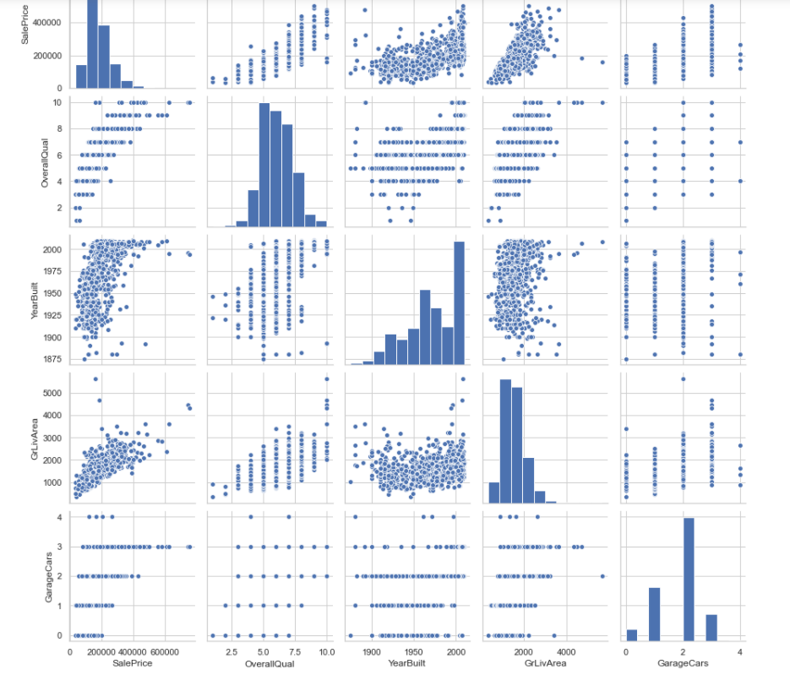
Observation:
SalePrice is highly positively correlated with GrLivArea and OverallQual.

Slide 11
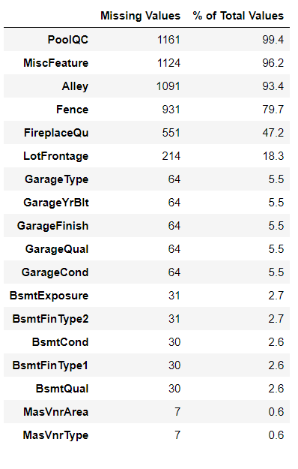
Steps and assumptions used to complete the project
Data Preprocessing Done
We first done data cleaning. We first looked percentage of values missing in columns then we imputed missing values .

Slide 12
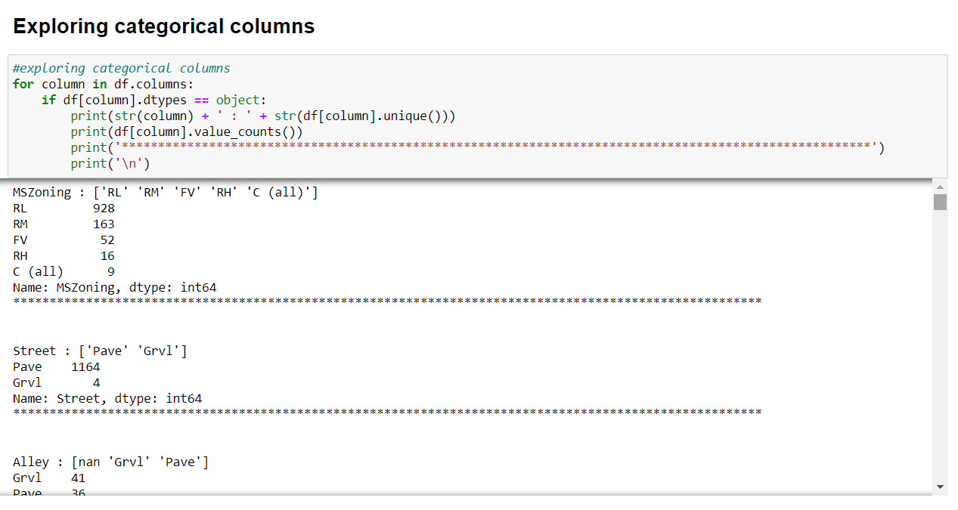
We then explored categorical variables
We observed that there is only one unique value present in Utilities so will be dropping this column.

Slide 13
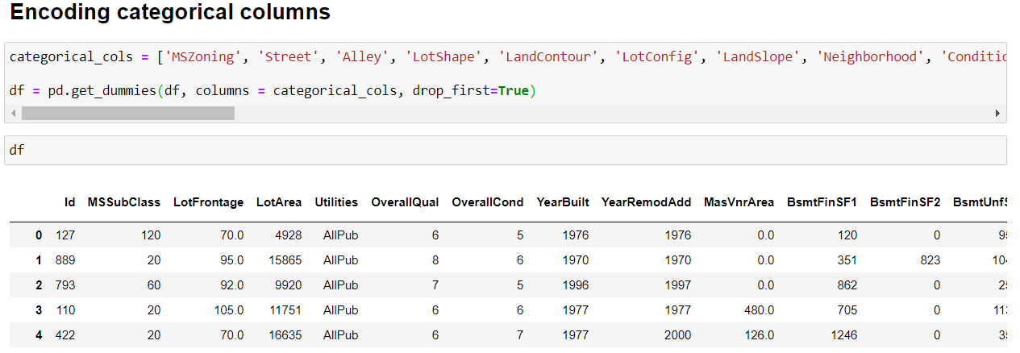

Then we encoded all the categorical columns into numerical columns using dummy variables.

Slide 14
While checking the heatmap of correlation we observed that,
1. SalePrice is highly positively correlated with the columns OverallQual, YearBuilt, YearRemodAdd, TotalBsmtSF, 1stFlrSF, GrLivArea, FullBath, TotRmsAbvGrd, GarageCars, GarageArea.
2. SalePrice is negatively correlated with OverallCond, KitchenAbvGr, Encloseporch, YrSold.
3. We observe multicollinearity in between columns so we will be using Principal Component Analysis(PCA).
4. No correlation has been observed between the column Id and other columns so we will be dropping this column.

Slide 15
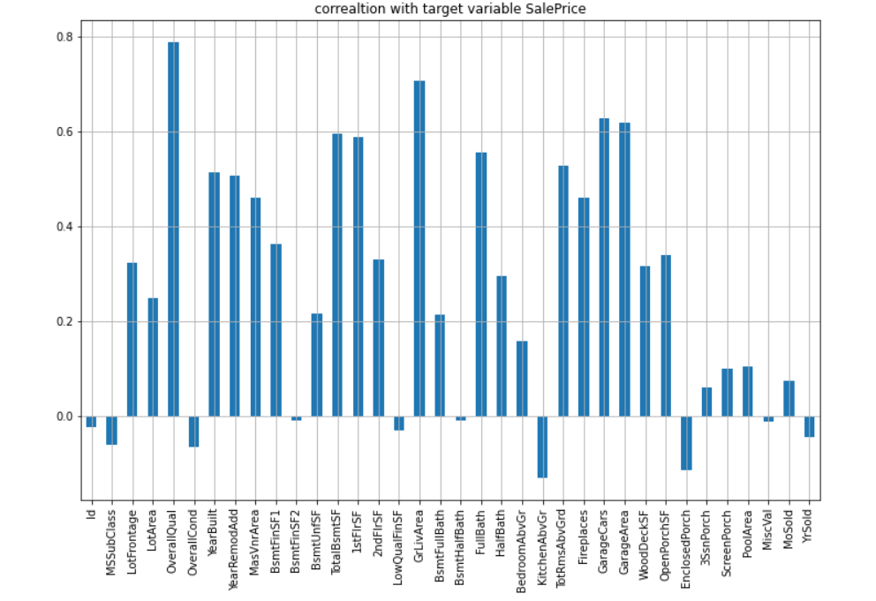
Here we check the correlation between all our feature variables with target variable label.
1. The column OverallQual is most positively correlated with SalePrice.
2. The column KitchenAbvGrd is most negatively correlated with SalePrice.

Slide 16
Problem-Solving Approaches
We first converted all our categorical variables to numeric variables with the help of dummy variables to checkout and dropped the columns which we felt were unnecessary.
We observed skewness in data, so we tried to remove the skewness through treating outliers with winsorization technique.
The data was improper scaled, so we scaled the feature variables on a single scale using sklearn’s StandardScaler package.
There were too many (256) feature variables in the data, so we reduced it to 100 with the help of Principal Component Analysis(PCA) by plotting Eigenvalues and taking the number of nodes as our number of feature variables.

Slide 17
By looking into the target variable label we assumed that it was a Regression type of problem.
We observed multicollinearity in between columns so we assumed that we will be using Principal Component Analysis (PCA).
We also observed that only one single unique value was present in Utilities column so we assumed that we will be dropping this columns.
Set of assumptions related to the problem under consideration

Slide 18
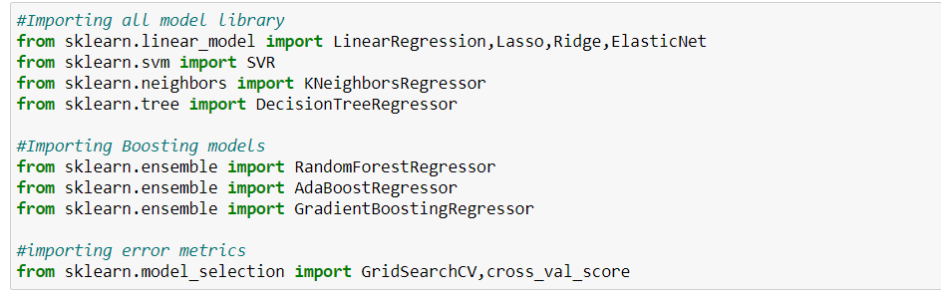
Model Dashboard

Slide 19
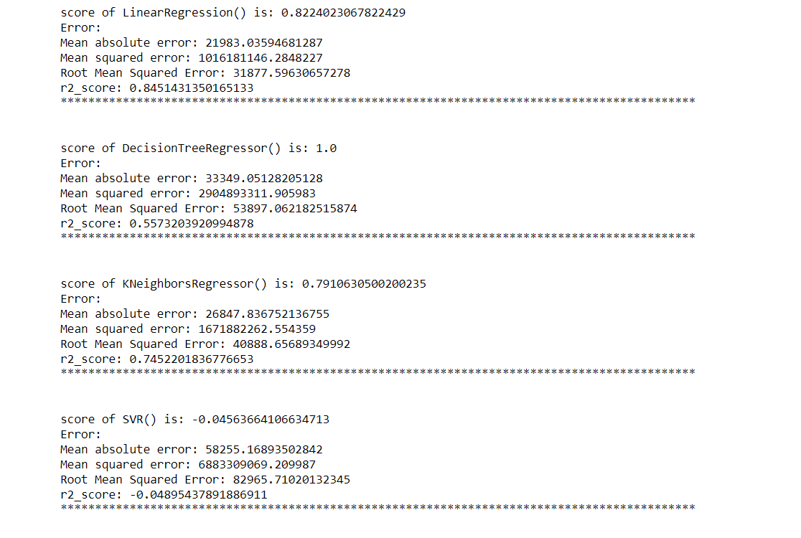

Slide 20
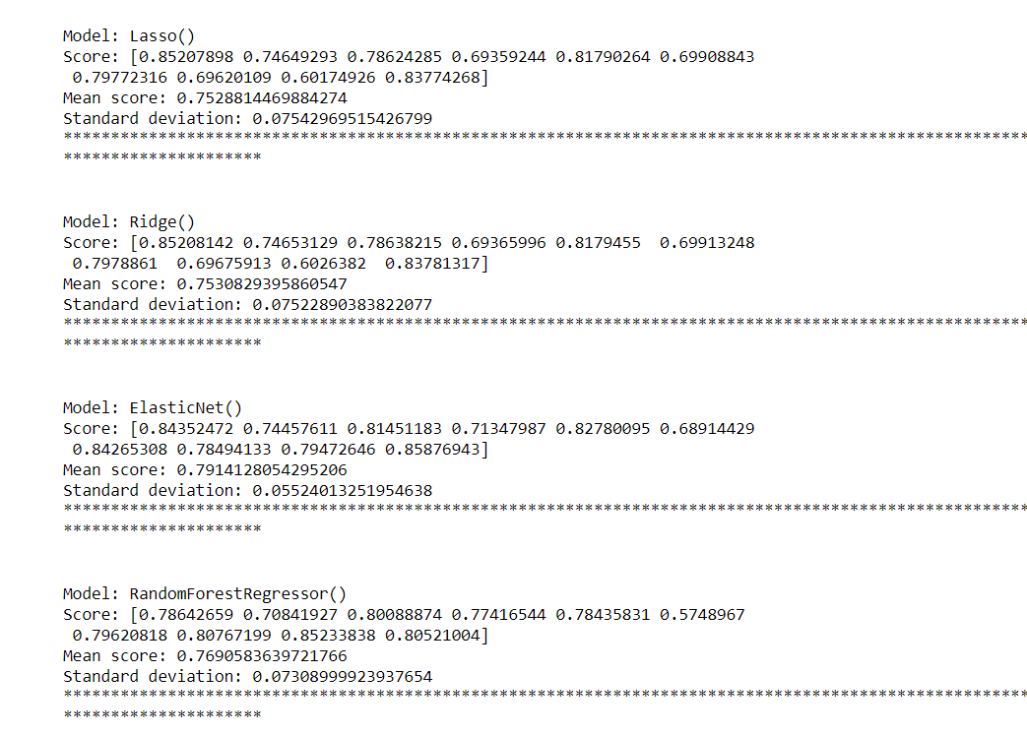

Slide 21
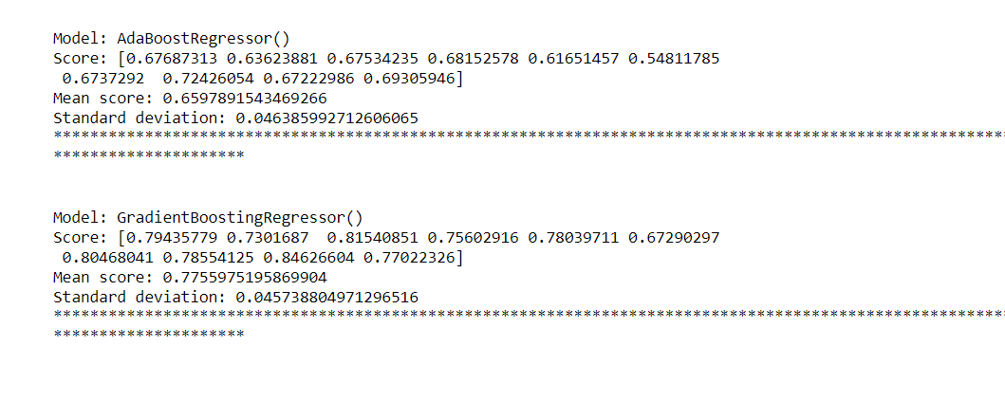

Slide 22
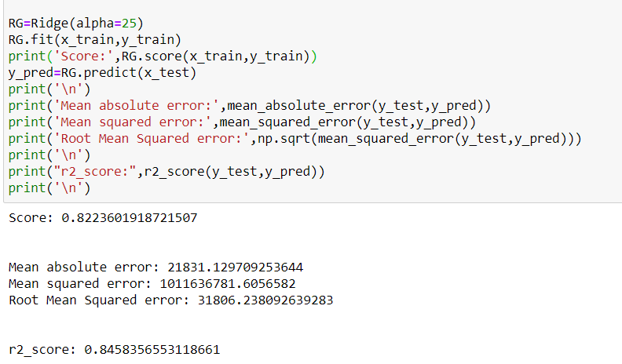
Finalized Model

Slide 23
Conclusion
In this project we have tried to show how the house prices vary and what are the factors related to the changing of house prices. The best(minimum) RMSE score was achieved using the best parameters of Ridge Regressor through GridSearchCV though Lasso Regressor model performed well too. While we couldn’t reach out goal of minimum RMSE in house price prediction without letting the model to overfit, we did end up creating a system that can with enough time and data get very close to that goal.

Slide 24
I would like to express my special thanks of gratitude to the sources Medium, TowardsDataScience, StackOverflow, KrishNaik’s youtube channel which helped me to accomplish this project.
Acknowledgement

